Slide 1
CS 4530: Fundamentals of Software Engineering
Module 08: Concurrency Patterns in Typescript
Adeel Bhutta and Mitch Wand
Khoury College of Computer Sciences
© 2026 Released under the CC BY-SA license

Slide 2
Learning Goals for this Lesson
At the end of this lesson, you should be prepared to:
  Explain the difference between JS run-to-completion semantics and interrupt-based semantics.
  Given a simple program using async/await, work out the possible orders in which the statements in the program will run.
  Write simple programs that create and manage promises using async/await
  Write simple programs to mask latency with concurrency by using non-blocking IO and Promise.all in TypeScript.
Notes:
<read slide>

Slide 3
Why async matters
Your browser probably spends 99% of its time waiting
  for http requests to return
  for database calls to return
Wouldn't it be nice if we could use that waiting time for something else?
  maybe we have some other http request we could launch
  maybe other things (throbbers??)

Slide 4
Typescript/JavaScript achieves this goal using two techniques:
1. non-blocking IO
2. cooperative multiprocessing

Slide 5
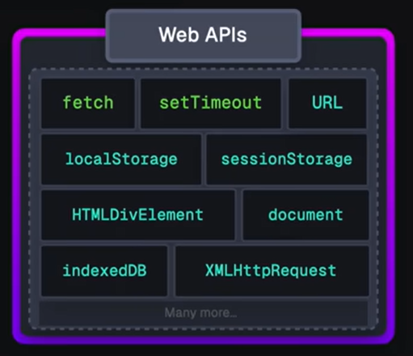
Part 1: JS/TS in your browser has some primitives for doing non-blocking I/O
This is called the "Web API"
These are things like http requests, I/O operations, or timers
Each of these returns a promise that you can await. The promise runs while it is pending, and produces the response from the http request, or the contents of the file, etc.
You may use some of these directly, like fetch or setTimeout.
More frequently, you will invoke these using a convenient library, like
axios.get('https://rest-example.covey.town’)
to make an http request, or
fs.readFile(filename)
to read the contents of a file.
Notes:
IO operations are async functions that return promises and you can await on them.
Using WebAPI is like outsourcing of jobs. WebAPI uses browser to run these jobs and browser can run things using multiple threads.

Slide 6
Part 2: Javascript/Typescript uses cooperative multiprocessing
In cooperative multiprocessing, only one process is executed at a time.
Each process pauses when it is convenient to allow other processes to make progress. Pause also means ‘yield’
To make this practical (and avoid cheating!), we need a programming model that encourages this behavior
Notes:
In cooperative multiprocessing, each thread decides when it should yield to let other threads execute. For the purposes of this lecture, we will use the terms 'promise' and 'computation' interchangeably (MAYBE??)

Slide 7
async/await is a programming model for cooperative multiprocessing
In async/await, the program is organized into a set of "async functions“
An async function always returns a promise.
If you await on a promise, your program pauses its execution until async function is completed.
When one program pauses, the runtime can choose to resume executing any process that is ready to run.
Notes:
Two key concepts that we want to understand today are:
-when you await for a promise to be completed, you pause your execution or yield
-when you yield, runtime can execute some other task.

Slide 8
Quick Review of Promises (from M04)
Typescript uses the type system to distinguish long-running computations
A long-running (IO-bound) computation gets type Promise<DataRecord>, rather than DataRecord.
async functions return Promises
Use await to get the result of a promise
Every occurrence of await must be in an async function
A Promise<void> is executed for effect, so it doesn't make sense to await its result.

Slide 9
A promise can be in one of exactly 3 states
A JavaScript promise can be in one of three states: pending, fulfilled, or rejected.
Pending is the initial state where the promise is waiting for an operation to complete; Then it becomes Ready for Execution; and eventually it is Executing before being resolved
Resolved: either fulfilled or rejected.
  fulfilled means the operation was successful,
  rejected indicates that the operation failed.
Notes:
<read slide>. Say something about success/failure?

Slide 10
Async functions return Promises
async function someFunction(i: number) : Promise<number> {
const j = i + 1;
// ...
const k = await someOtherAsyncFunction(j);
// ...
const m = k + 100
return m;
}
Notes:
Here's a typical async function. It calls another async function, waits for that function to return, and then does something with the answer. The "cooperative multiprocessing" means that while this function is waiting for the other function to return, the runtime can switch to some other task.

Slide 11
This function returns a promise that will resolve with m.
async function someFunction(i: number) : Promise<number> {
const j = i + 1;
// ...
const k = await someOtherAsyncFunction(j);
// ...
const m = k + 100
return m;
}
Notes:
someFunction returns a promise that will wait for someOtherAsyncFunction to resolve, call the result k, and then return m (= k+100).

Slide 12
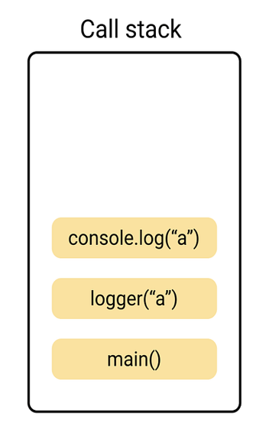
Run to Completion is a central concept
In JS, you work on one and one task only (i.e., event loop has a single call stack)
Also, if you start a task, you must finish it (i.e., call stack must be emptied) before you start another task. This pattern is called "run-to-completion" semantics
A task can be paused in exactly two places:
  when it reaches an await
  when it reaches a return
Notes:
run to completion means that if you start executing a task (or async) function then it must complete unless it awaits on something

Slide 13
This function can only be paused in certain places
async function someFunction(i: number) : Promise<number> {
const j = i + 1;
// ...
const k = await someOtherAsyncFunction(j);
// ...
const m = k + 100
return m;
}
It will never pause in
here. This is called a
Critical Section
Or in here (this is
another Critical Section)
Notes:
By disallowing interrupts everywhere but at the pause points, we avoid almost all of the data races you may have learned about in your operating systems class. Each green box is a critical section, and your program consists of a set of critical sections. Each green box is uninterruptible!!
Everything after the await, including the second green box is the ‘awaited work’ that will be processed later!

Slide 14

What happens at those pause points?
async function someFunction(i: number) {
const j = i + 1;
// ...
const k = await someOtherAsyncFunction(j);
// ...
const m = k + 100
return m;
}
Pause points
Notes:
An async function yields or pauses in exactly two places in its code. What happens at those places?
When someFunction yields at the first location, it first informs the runtime that someOtherAsyncFunction(j) is ready to run, and that someFunction will be ready to resume its execution only when someOtherAsyncFunction(j) returns a value (i.e., it is returning to caller with a pending promise). The runtime can then switch to any process that is ready.
When someFunction yields at the second location, it informs the runtime that it is ready to return to its caller, and the runtime will switch to any process that is ready. It might be the caller of someFunction, or it might be something else.

Slide 15
What happens when you await?
When you ‘await’ you are inside some async procedure.
In the body of that procedure, if you await on some task, you are cooperating with the event loop by allowing it to work on something else.
In technical terms, you are returning (to the caller of the original async procedure) with a pending promise which means that some work will be completed in the future.
While you are waiting for that future, event loop will continue finishing its current task (whatever is in call stack) and then other tasks (whatever is in callback queue).
Eventually the event loop will complete the awaited work.
Notes:
There are three key points to highlight
1. When you await, you are in some async
When you await on a task, you return to the caller of the async procedure with a pending promise
The caller Ican continue its work

Slide 16
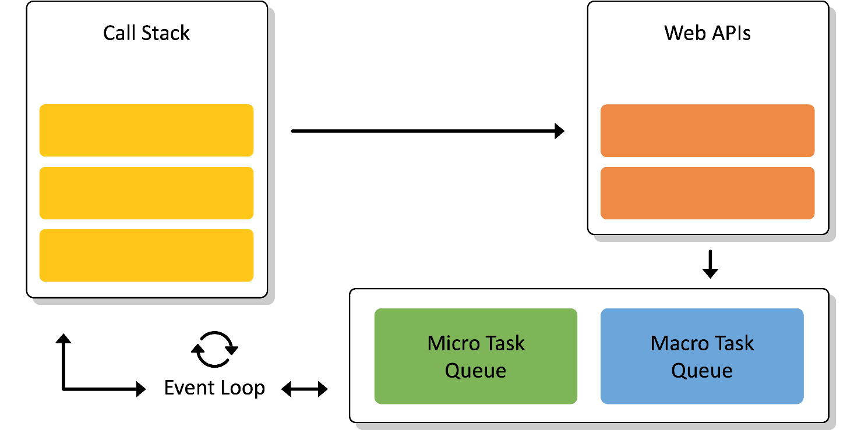
How does JS Event Loop make this happen?
Event Loop with one Call Stack means that we have single thread of execution
The WebAPI is used for asynchronous tasks
Queues are used for “await”-ed tasks
When call stack becomes empty, the event loop picks up tasks from Callback Queues
Notes:
<read slide>.
- JS Engine includes a {single} call stack that keeps track of each function that it is being executed
- Asynchronous (heavy) tasks are outsourced to WebAPI. When those are completed, they are placed in a callback queue.
Event loop picks up “awaiting” {completed} tasks from queue when call stack is empty (i.e., when it is done with everything it was working on – think run to completion) and processes them in the order they were added to queue (i.e., they were completed by WebAPI)
We’ll talk about the “micro task queue” and “macro task queue” in a few minutes.

Slide 17
Let’s start with a simple request
src/Slides/oneRequest.ts
// fakeRequest(n) is an async that waits for 1 second and then
// resolves with the number n+10
import { fakeRequest } from "./fakeRequest";
import timeIt from "./timeIt";
async function main() {
console.log('main started');
const res = await fakeRequest(32);
console.log(`fakeRequest(${request}) returned: ${res}`);
console.log('main done');
}
timeIt(main)
$ node oneRequest.ts
main started
fakeRequest received request: 32
time passes....
fakeRequest(32) returned: 42
main done
1015.98 msec
Notes:
Review the code. main() waits for the request to return, and then continues. It is just a 1 second delay
Awaiting allows us to wait for some task to complete first before we do something else.

Slide 18
Pattern for starting a concurrent computation using non-blocking I/O
import axios from 'axios';
export async function makeRequest(requestNumber:number) {
console.log(`starting makeRequest(${requestNumber})`);
const response = await fetch('https://rest-example.covey.town');
console.log(`request:${requestNumber} returned`);
}
function makeOneRequest() {
console.log('starting makeOneRequest');
makeRequest(100);
console.log('makeOneRequest finished');
}
makeOneRequest()
console.log (‘starting makeR…’)
fetch('https://rest…');
console.log(‘makeO… finished’);
makeRequest (100)
console.log(‘starting makeO …’);
P1
makeOneRequest
Now, call stack can complete the awaiting work (console.log)
Response from fetch
Notes:
This is a common pattern for async functions using live http request running as non-blocking IO.
makeOneRequest calls makeRequest which makes an API call.
As you await for the fetch to respond, makeOneRequest function (the caller) can continue and finish.
When call stack is empty, response from fetch can be printed (Awaiting work).

Slide 19
Pattern for starting a concurrent computation using non-blocking I/O
export async function makeRequest(requestNumber:number) {
console.log(`starting makeRequest ${requestNumber}`);
const response = await fetch('https://rest-example.covey.town');
console.log('request:', requestNumber, '; response:', response.data);
}
console.log("main thread is about to call makeRequest");
makeRequest(1000);
console.log("main thread continues after makeRequest returns");
console.log("end of main thread")
First console is printed
fetch starts the http request immediately in the background using non-blocking IO, and creates a promise to do the code after the await.
3. The call to makeRequest returns with this pending promise
4. The main thread finishes.
5. Sometime later, the computation resumes the promise
$ node makeOneRequest.ts
main thread is about to call makeRequest
starting makeRequest 1000
main thread continues after makeRequest returns
end of main thread
Request: 1000; response: 200
Notes:
Let’s go through this example again. (It’s important enough to repeat).

Slide 20
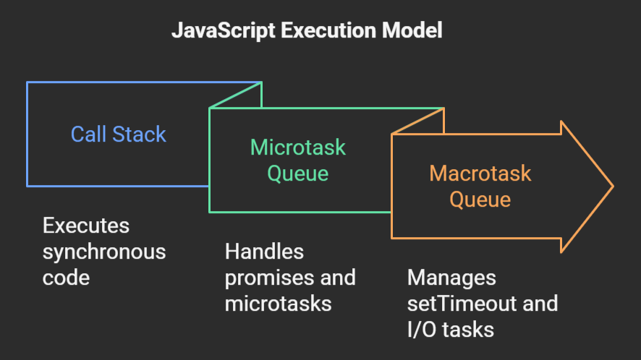
Promises come in two flavors: microtasks and macrotasks
Microtask queue is used for immediate/urgent tasks while Macrotask queue is used for slower asynchronous tasks.
When call stack is empty, microtask queue is processed first (before browser renders). When microtask queue is empty then macrotask queue is processed.
Notes:
JavaScript microtasks (Promises, MutationObserver) have higher priority than macrotasks (setTimeout, I/O), executing immediately after the call stack empties and before the next event loop iteration. The event loop processes all available microtasks before running a single macrotask.
Key Differences at a Glance:
Priority: Microtasks are executed immediately after the current task and before the browser renders, while macrotasks are processed one by one, allowing rendering to happen between them.
Order: If a microtask adds another microtask, it is executed in the same cycle. If a macrotask adds a microtask, it is also executed before the next macrotask.
Usage: Microtasks are for urgent, immediate post-processing (e.g., Promise resolutions). Macrotasks are for slower, asynchronous operations (e.g., setInterval, fs.readFile in Node.js).
Examples of Tasks
Microtasks: Promise callbacks (.then/.catch/.finally), queueMicrotask(), MutationObserver.
Macrotasks: setTimeout(), setInterval(), setImmediate() (Node.js), I/O operations, UI rendering events, EventHandler Callbacks

Slide 21
Macrotasks are API calls; Microtasks are what you do after the API call returns
async function someFunction(i: number) {
const j = i + 1;
// ...
const k = await someOtherAsyncFunction(j);
// ...
const m = k + 100
return m;
}
This will be a macrotask
This will be a microtask

Slide 22
By contrast, most OS's use pre-emptive multiprocessing
OS manages multiprocessing with multiple threads of execution
Processes may be interrupted at unpredictable times
Inter-process communication by shared memory
Data races abound
Really, really hard to get right: need critical sections, semaphores, monitors (all that stuff you learned about in op. sys.)
Notes:
In many programming languages, like Java or C, you can have asynchronous computation with threads.
You might be familiar with this programming model. As it turns out, the “inter-process communication by shared memory” part is extremely hard to get right, and almost impossible to prove correct
This is not how JS or TS does asynchronous computation.

Slide 23
Java vs. JS/TS
src/Slides/criticalSection.ts
async function asyncPrintA() {
await waitRandom(1);
console.log('A');
}
async function asyncPrintBC() {
await waitRandom(2);
console.log('B');
console.log('C');
}
export async function run() {
await Promise.all([asyncPrintA(), asyncPrintBC()])
}
In Java, he easiest thing to do is to set up two threads
But then you could get an interrupt between the print B and the print C.
So the output could be ABC, BAC, BCA
In TS/JS, the print B and print C are in the same critical section, so BAC is impossible!
(TBH, you can set this up in Java in a way that avoids the interrupt, but it takes some care ☺)
Notes:
In an interrupt-based model, it is possible that statement the print A runs *between* the print B and the print C. Not for us!
(Don't worry about the Promise.all- we'll explain that soon).

Slide 24
Let’s work with more complicated examples: Three Requests, sequentially
$ node threeRequestsSequentially.ts
starting main
fakeRequest received request: 1
time passes....
fakeRequest(1) returned: 11
fakeRequest received request: 2
time passes....
fakeRequest(2) returned: 12
fakeRequest received request: 3
time passes....
fakeRequest(3) returned: 13
main done
3024.03 msec
async function main() {
console.log('starting main');
const res1 = await fakeRequest(1);
console.log(`fakeRequest(1) returned: ${res1}`);
const res2 = await fakeRequest(2);
console.log(`fakeRequest(2) returned: ${res2}`);
const res3 = await fakeRequest(3);
console.log(`fakeRequest(3) returned: ${res3}`);
console.log('main done');
}
await timeIt(main)
src/Slides/threeRequestsSequentially.ts
Notes:
By contrast, here we wait for each request to return before issuing the next one. Each fakeRequest takes 1000 msec, and we can see that the whole thing took 3000 msecs-- no concurrency here!

Slide 25
Use Promise.all to execute several requests concurrently
Promise.all takes a list of Promise<T> and creates a Promise<T[]>
  ie, a promise that resolves to a list of T's
When executed, this promise runs them concurrently,
and resolves with the list of values
  (assuming they all resolve successfully)
Notes:
<read slide>

Slide 26
Use Promise.all to execute several requests concurrently
src/Slides/threeRequestsConcurrently.ts
async function main() {
console.log('starting main');
const promises = [fakeRequest(1),
fakeRequest(2),
fakeRequest(3)];
const results = await Promise.all(promises);
console.log('results:', results);
console.log('main done');
}
await timeIt(main)
$ node threeRequestsConcurrently.ts
starting main
fakeRequest received request: 1
fakeRequest received request: 2
fakeRequest received request: 3
time passes....
time passes....
time passes....
results: [ 11, 12, 13 ]
main done
1018.81 msecno
Notes:
Here's an example of starting several requests concurrently. Remember that each call to fakeRequest() takes 1 second (1000 msecs), and here we completed 3 of them in just over 1 second. So something in these three requests must have run concurrently.
In this case, it was the timers in the three fakeRequests that ran concurrently. Had this been a real request (say an http request or a database fetch), those requests would be "in-flight" concurrently. We'll see this in more detail in a few minutes.
Note that if any of the promises fail, then the Promise.all fails (we'll talk about promise failure a little later).

Slide 27
Why is that?
Visualizing Promise.all
“Don’t make another request until you got the last response back”
Sequential (await)
3024 msec
send
wait
receive
send
wait
receive
send
wait
receive
“Make all of the requests now, then wait for all of the responses”
Concurrent (Promise.all)
1018 msec
send
wait
receive
or
send
wait
receive
send
wait
receive
send
wait
receive
send
wait
receive
send
wait
receive
Notes:
In both cases, there is at most one active promise (in green) at any time! But the concurrent version "masks latency with concurrency", as we said way back on slide 1.

Slide 28
Promise.all results may arrive out of order, but are always reported in the order they are listed
src/Slides/outOfOrderReturns.ts
// realRequest calls out to an external REST AP
// and returns the request number + 10
// logs the request number when it starts and when it returns.
// ignores the response.
async function main() {
console.log('starting main');
const promises = [realRequest(1),
realRequest(2),
realRequest(3)];
const results = await Promise.all(promises);
console.log('results:', results);
console.log('main done');
}
await timeIt(main);
$ node outOfOrderReturns.ts
starting main
request 1 started
request 2 started
request 3 started
request 2 returned 12
request 1 returned 11
request 3 returned 13
results: [ 11, 12, 13 ]
main done
254.60 msec
Notes:
Note that these requests started 1,then 2,then 3, but returned in order 2, then 3, then 1.

Slide 29
Recover from errors with try/catch
// a request that may fail
async function maybeFailingRequest(req: number): Promise<number> {
const res = await fakeRequest(req);
if (res < 0) {
throw new Error(`Request ${req} failed because response ${res} < 0`);
} else {
return res;
}
}
src/Slides/tryCatchExample.ts
Notes:
asyncs play nicely with try/catch. Here we've tweaked fakeRequest so that it will sometimes throw an error, and here's a wrapper that recovers from those errors (by returning 0).

Slide 30
try/catch, continued
async function main() {
console.log('main started');
const req1 = -32
let res: number;
try {
res = await maybeFailingRequest(req1);
console.log(`fakeRequest(${req1}) returned: ${res}`);
} catch (err) {
console.error(`Error occurred for request ${req1}`);
res = 0
}
console.log('main done with res =', res);
}
timeIt(main);
$ node tryCatchExample.ts
main started
fakeRequest received request: -32
time passes....
Error occurred for request -32
main done with res = 0
1007.52 msec

Slide 31
Pattern for testing an async function
import { fakeRequest } from './fakeRequest.ts'
import { describe, expect, test} from 'vitest'
// fakeRequest should make a network request using myFetch
// and then returns n + 1
describe('fakeRequest', () => {
test('fakeRequest should return its argument + 1 (await/expect)', async () => {
expect.assertions(1)
await expect(fakeRequest(100)).resolves.toEqual(101)
})
test('fakeRequest should return its argument + 1 (expect/await)', async () => {
expect.assertions(1)
expect(await fakeRequest(7)).toEqual(8)
})
src/Slides/example.spec.ts
Notes:
Let's change the subject. How do you test an async function? To test an async function, make the second argument to ‘test’ an async function. This will make ‘expect’ itself an async function, so you will need to ‘await’ its result. Calling expect.assertions checks to make sure that your test properly awaited the result of the request.
This example is easy, since we are only sending some data to a public web site. If we wanted to do something that might have a global effect (e.g. a transcript database), we'd have to do some mocking. Alas, that is too much for this lecture ☺.
The expect.assertions (in blue) tells Vitest that the test should run exactly 1 expect statement, so that will make the test fail if you leave out the await.

Slide 32
Other things you should know about async

Slide 33
async doesn't eliminate data races
src/Slides/dataRace.ts
import { myFetch } from './fakeRequest.ts';
const log: string[] = [];
async function X(n: number) {
await myFetch(1)
log.push('X');
}
async function Y(n: number) {
await myFetch(2)
log.push('Y');
}
for (let i = 0; i < 4; i += 1) {
log.push('start');
await Promise.all([X(10), Y(20)]);
}
console.log(log);
$ node dataRace.ts
Promise created for 1
Promise created for 2
Promise created for 1
Promise created for 2
Promise created for 1
Promise created for 2
Promise created for 1
Promise created for 2
[
'start', 'X', 'Y',
'start', 'Y', 'X',
'start', 'Y', 'X',
'start', 'Y', 'X'
]
Notes:
We've already seen non-deterministic behavior reflected in our console logs. But that kind of behavior can easily become visible to our program. All you need is some shared state across your promises.
In the code above, X and Y are run concurrently (4 times) and depending on which functions finishes first, X or Y is pushed to log first.
The activity explores this topic in more depth.

Slide 34
Async/await code is compiled into promise/then code. Using await is preferred
async function makeThreeSerialRequests(){
1. console.log('Making first request’);
2. await makeOneGetRequest();
3. console.log('Making second request’);
4. await makeOneGetRequest();
5. console.log('Making third request’);
6. await makeOneGetRequest();
7. console.log('All done!');
}
makeThreeSerialRequests();
console.log('Making first request');
makeOneGetRequest().then( () =>{
console.log('Making second request');
return makeOneGetRequest();
}).then(() => {
console.log('Making third request');
return makeOneGetRequest();
}).then(()=>{
console.log('All done!');
});
Notes:
You will occasionally see code written in this style. The main request is a macrotask; the .then() blocks become microtasks. The "return" in a microtask is also a pause point.

Slide 35
AntiPattern: unawaited promise
src/Slides/oneRequestNoAwait.ts
Lint says:
STOP
// fakeRequest(n) is an async that waits for 1 second and then
// resolves with the number n+10
import { fakeRequest } from "./fakeRequest";
import { timeIt } from "./timeIt";
async function main() {
console.log('main started');
const request = 32
const res = fakeRequest(request);
console.log(`fakeRequest(${request}) returned: ${res}`);
console.log('main done');
}
timeIt(main)
$ node oneRequestNoAwait.ts
main started
fakeRequest received request: 32
fakeRequest(32) returned: [object Promise]
main done
2.64 msec
time passes....
Notes:
Common mistake is not to await on async task. This would mean that you are proceeding with some work without getting a valid response. Luckily, our standard lint setup has a rule for this.

Slide 36
Promises have priority (Micro over Macro)
src/Slides/microOverMacro.ts
async function main(): Promise<void> {
console.log('main started');
await createMacrotask();
console.log('executing microtask1');
console.log('executing microtask2');
}
// creates a macrotask, but returns something else.
async function createMacrotask(): Promise<void> {
console.log('creating macrotask');
const _ignored = new Promise<void>((resolve) => {
setTimeout(() => {
console.log('executing macrotask');
resolve();
}, 0);
});
// return a promise that immediately resolves.
return Promise.resolve();
}
await main();
$ node microOverMacro.ts
main started
creating macrotask
executing microtask1
executing microtask2
executing macrotask
Notes:
If multiple promises are resolved, the ones in the microtask queue will always be reported first. Here createMacrotask creates a new Promise, which goes on the microtask queue. But the two microtasks will always get executed before the microtask. (Sorry If that’s confusing; I find it nitpicky, too. But we want to give you an accurate model of how async works in Javascript).

Slide 37
Review of Rules for Writing Asynchronous Code
Await async procedures only from other async functions or from the top level.
You can’t return a value from a promise to an ordinary procedure.
  You can only send the value to another promise that is awaiting it.
Break up any long-running computation into async/await segments so other processes will have a chance to run.
Leverage concurrency when possible
  Use promise.all if you need to wait for multiple promises to return (or Promise.allSettled, if needed).
Check for errors with try/catch

Slide 38
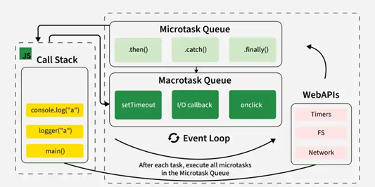
Let’s put it all together
JS/TS has single event loop
We outsource most of the work to WebAPIs for asynchronous work
Upon completion, they are placed in queues.
Event loop picks them up from queue when call stack is empty!
Notes:
Javascript is a single threaded language. This means it has one call stack and one memory heap. It uses WebAPI to work asynchronously.
How do we get asynchronous code with Javascript then?
Well, we can thank the Javascript engine (V8, Spidermonkey, JavaScriptCore, etc...) for that, which has Web API that handle these tasks in the background. The call stack recognizes functions of the Web API and hands them off to be handled by the browser. Once those tasks are finished by the browser, they return and are pushed into a queue (callbacks go in Macrotask queue and promises go into microtask queue)
Then they are picked up by the event loop one by one and added onto the call stack.
Try this http://latentflip.com/loupe

Slide 39
Review
You should now be prepared to:
  Explain the difference between JS run-to-completion semantics and interrupt-based semantics.
  Given a simple program using async/await, work out the possible orders in which the statements in the program will run.
  Write simple programs that create and manage promises using async/await
  Write simple programs to mask latency with concurrency by using non-blocking IO and Promise.all in TypeScript.
Notes:
<read slide>

